Slide 1
Loving and Trusting God in the Job Search
Pre-Release workbook and planning guide for
Returning Citizens
© 2014 Metanoia Prison Ministries, Special Thanks to Alan Bonderud

Slide 2
Purpose
To give you some tools that will help you find work
To provide (for some of you) a different perspective to help you find and keep work
To demonstrate how we can love and trust God in every aspect of the job search
Metanoia Prison Ministries
2

Slide 3
Job Search Fundamentals
Resume
Cover letter
Interview
Follow-up
Understanding that this is a campaign, not a one-time shot
Good preparation is a key to your success
Know that the root of our success and our sanity lies with the source of everything good in our lives -- God
Metanoia Prison Ministries
3

Slide 4
Why do we work?
Beginning in Genesis, there was work to be done. Man was told to subdue and rule the earth for the glory of God (Genesis 1:26-28).
The fourth commandment underscores the requirement of work. Six days shall you labor and do all your work, but the 7th is a Sabbath to the Lord your God. In it you shall rest.. The moral law assumes work as the normal course of life, punctuated by periods of rest.
Our God is the God who plans, who creates, who builds, who has an eye for shape, for symmetry, for color, shading, detail, harmony; who organizes and structures massive and intricate ecosystems, who integrates them and maintains them. We are made in His image and are to imitate Him.
It doesn’t matter what your work is, from yard work, assem-bly line work, professional work, public work, house work, home work. If it is lawful work, then you must see it as your calling from God and see His pleasure in your work. As God has distributed (or "assigned") to each one, as the Lord has called each one, so let him walk. (I Corinthians 7:17)
We are taught to work
We are to imitate God by working
We must honor God in our work
For we are God’s workmanship, created in Christ Jesus for good works, which God prepared beforehand, that we should walk in them. (Ephesians 2:10)
Taken from, “Work as a Calling” by Rev. Darwin Jordan
Metanoia Prison Ministries
4

Slide 5
Loving God and trusting Him is His will for our lives
What is the Lord’s will for my life?
Before work, or money or family or anything else, it is to love Him with all our hearts, souls, minds and strength
And, we love our neighbor as we love ourselves
Anything else?
Husbands and wives are to love each other
Do not exasperate your children to anger
Care for the widows and the orphans
Bring your whole tithe into the storehouse
Bear one another’s burdens
Seek justice, love mercy and walk humbly with your God
Etc., etc., etc.
These things we KNOW He wants us to do…
But where does work come in? I need a job!
Let’s not quibble with God. “Seek first the kingdom of God and His righteousness, and all these things will be added to you.” (Matt 6:33)
Come now you who say, “Today or tomorrow we will go to such and such a city, and spend a year there and engage in business and make a profit.” Yet you do not know what your life will be like tomorrow…Instead you ought to say, “If the Lord wills we will live and also do this or that.” (James 4:13-15)
Metanoia Prison Ministries
5

Slide 6
Finding the work He has prepared for us to do
Nothing is unknown to God
The job search is one of discovering His plan
“For we are His workmanship, created in Christ Jesus for good works, which God prepared beforehand so that we would walk in them.” (Ephesians 2:10)
The Christian has the tools
“All Scripture is inspired by God and profitable for teaching, reproof, correction and training in righteousness; so that the man of God may be adequate, be equipped for every good work.” (2Timothy 3:16)
Does this mean you will get rich? No.
It means you can have anything your heart desires that fits in the perfect plan of God for your life, which you can obtain as you employ the fruit of the Spirit: love, joy, peace, patience, kindness, goodness, faithfulness, diligence and self control.
“For I know the plans that I have for you,” declares the Lord, “plans for welfare and not for calamity to give you a future and a hope.” (Jeremiah 29:11)
“He who did not spare His own son, but delivered Him up for us all, how will He not also with Him freely give us all things?” (Romans 8:32)
Metanoia Prison Ministries
6

Slide 7
Do not be anxious
Worry and anxiety are the greatest enemy of successful job searches
Undermines enthusiasm and motivation
Destroys family relationships
Wrecks health
Leads to loss of sleep
Inclines us to find comfort in negative behaviors (i.e., eating)
Increases blood pressure, risk of heart attack, stroke
Leaves one in poor mindset for interviews
Interferes with the important things you must do now
Imaginings about tomorrow are not real; worry lets Satan come in to create doubt and confusion leading to personal brokenness
Of much greater importance, it shows we do not trust God
He is already there tomorrow and knows your path
He promises to do us good
Today REALLY does have enough trouble of its own!
“Do not be anxious about anything but in everything by prayer and petition, with thanksgiving, present your requests to God. And the peace of God , which surpasses all comprehension, will guard your hearts and minds in Christ Jesus.” (Philippians 4:6-7)
Jesus said, “So do not worry about tomor-row; for tomorrow will care for itself. Each day has enough trouble of its own.” (Matthew 6:34)
Metanoia Prison Ministries
7

Slide 8
What kind of God do we serve?
He is a good God
He is a loving God
He is a creative God
He is a merciful God
He is a caring God
He is a strong, mighty and all powerful God
He is a God who defends His own
He is a good shepherd of His flock
He is a beautiful and majestic God
He is a God who is unrelenting in his passion to do us good
He is a God who demonstrated that He will sacrifice for us
He is an interceding God
He is a holy God
He is a wonderful God
He is a wise God
He is an all knowing God
He is an ever-present God
He is a God jealous for his Name; He will not be mocked
He is (FILL IN THE BLANK)
Since we serve such a great God, let us be disciplined and use: a) the mind of Christ that He has given us, b) the Holy Spirit that indwells us, and c) the Word of God that instructs us…
To be disciplined and creative in launching --and sticking with-- a good solid job search that honors God.
Metanoia Prison Ministries
8

Slide 9
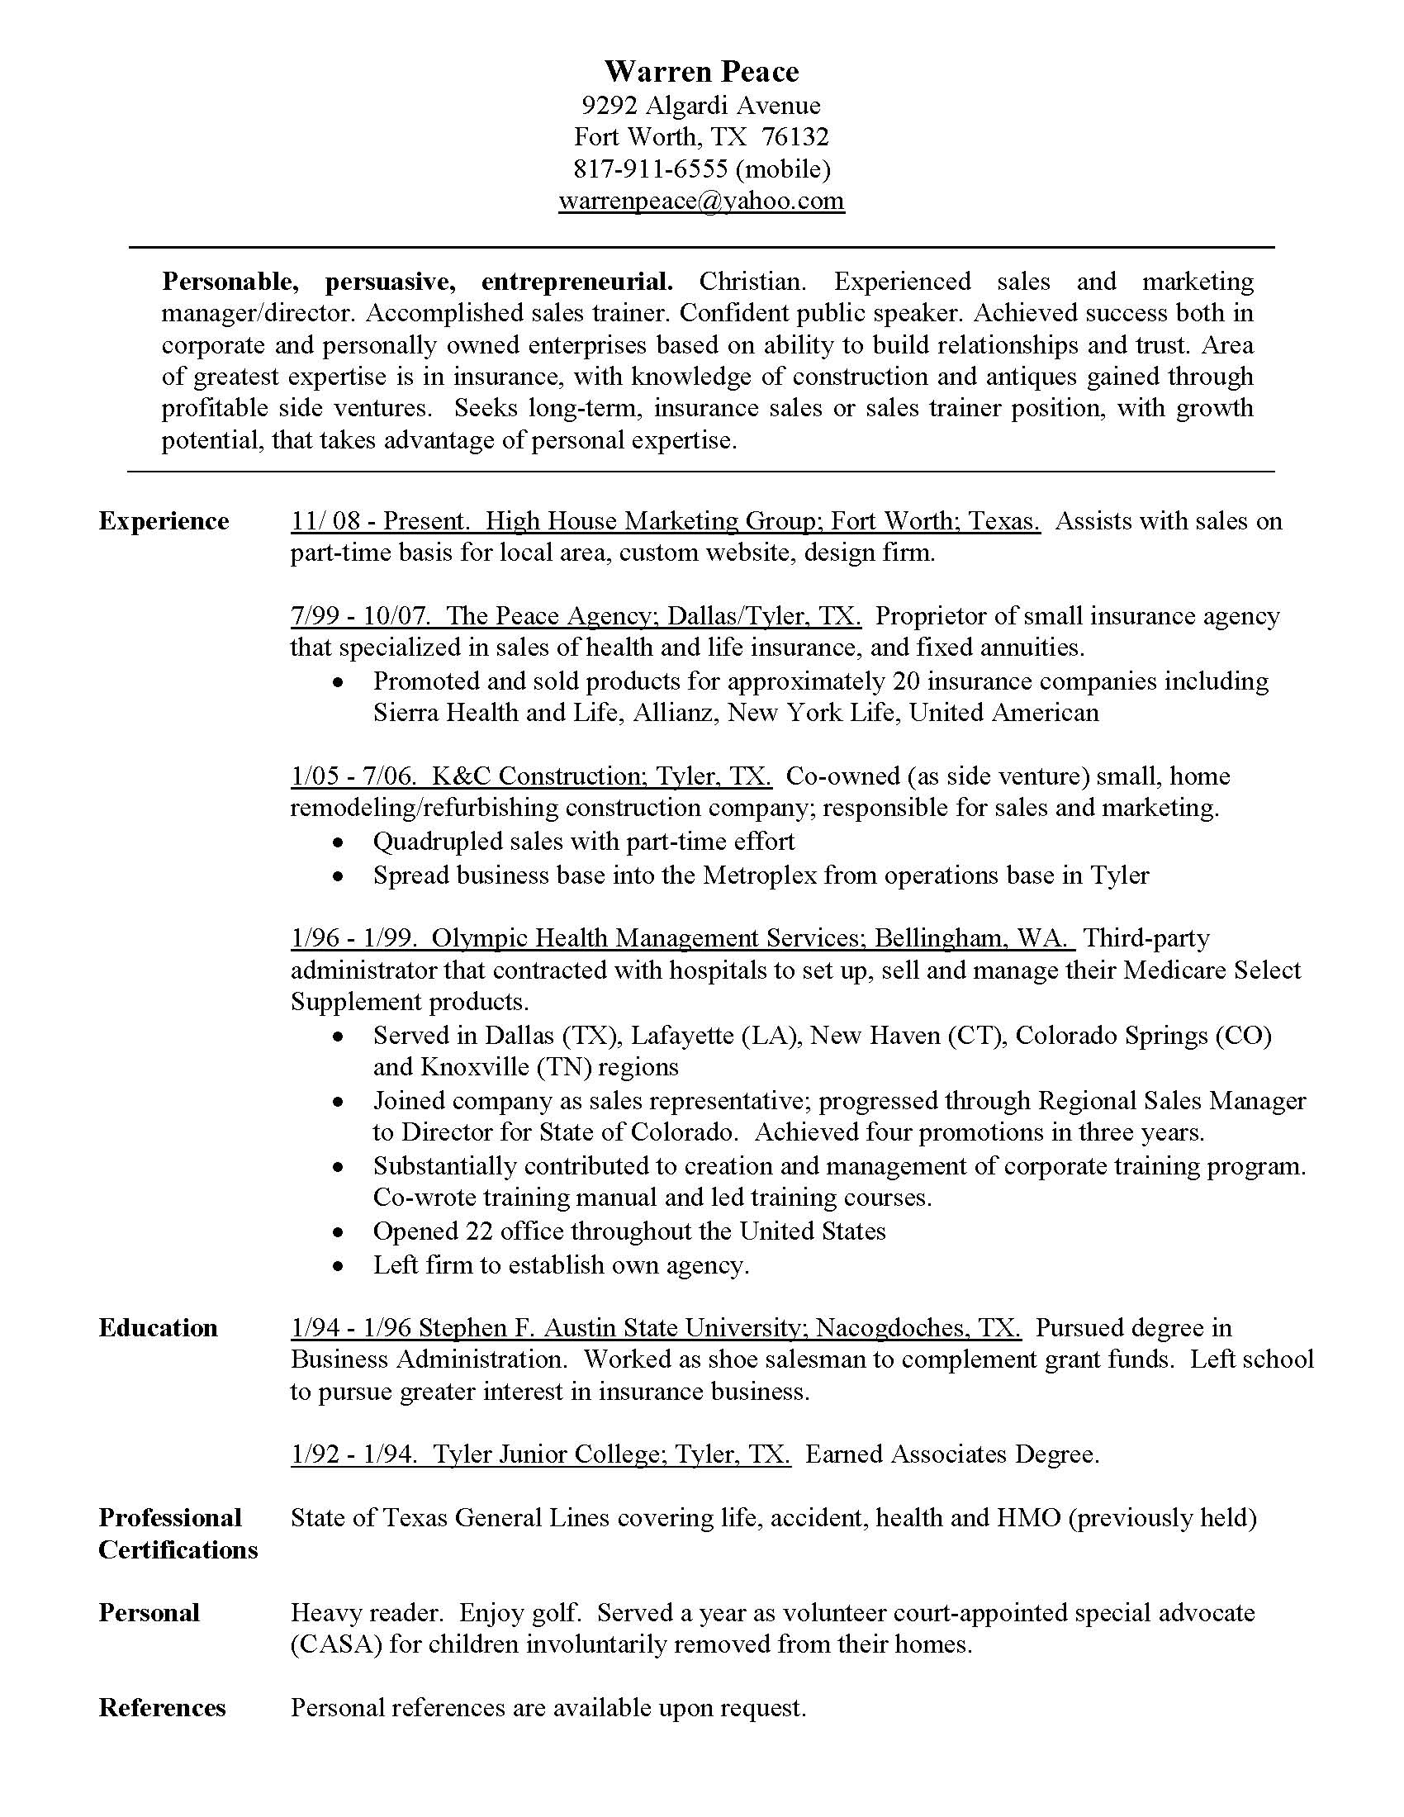
You need a good resume
Good clear format
Easy to adapt
Well thought out
Well punctuated
Few words; lots of white
Not many “I” “me” “my”
Tells your story
Must stand alone if separated from cover letter
Easy to upload
Metanoia Prison Ministries
9

Slide 10
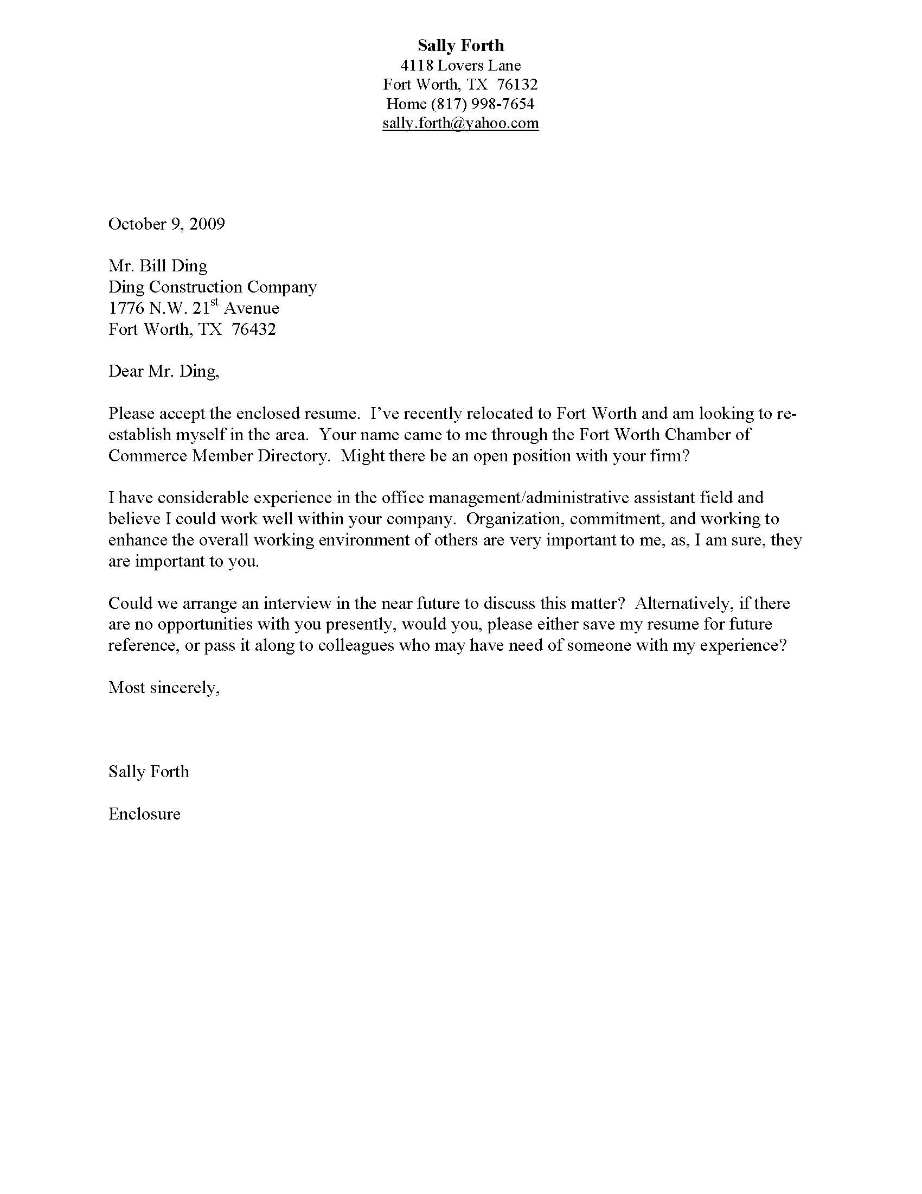
You need a good cover letter
Is sent to a person, not an address
Introduces you don’t miss chance to make a good first impression
Transmits resume
Tells your story - simply
Tells how you got their name
Draws them in with info about your character, skills, experience, etc.
Asks for the interview
Metanoia Prison Ministries
10

Slide 11
You must follow-up
Keep list of everywhere you sent the resume
If they responded in any manner, find a way to say, “thank you”, whether it is by phone, e-mail or letter
If they did not respond wait a few months and re-submit
It gives an open door to resubmit your resume
It makes a very good impression
Metanoia Prison Ministries
11

Slide 12
Preparation is the key
I arrived Fort Worth in 2008 under refugee status, directly from Baghdad, Iraq. The move was strongly supported by U.S. Embassy in Baghdad, my employer, due to challenging environment in which my personal security was threatened. Since arriving in U.S. I’ve obtained a social security card, a driver’s license, and work authorization, and am meeting conditions to obtain a green card. My sponsor is World Relief, and I’m assisted by Fort Worth Presbyterian Church.
Know the story you intend to tell
A good clear story fits in the cover letter and drives a good interview
Answers the interview question, “So, tell me a little about yourself.”
Be wise; don’t over-talk
Tell the truth. God is willing to do us good; let us honor Him in this
I owned my own business for ten years before succumbing to my success. I was given 10 years for felony DUI, which was commuted to an extended residential drug and alcohol treatment program. While there I gave my life to Christ. Upon getting out I affiliated with Fort Worth Presbyterian Church. I am involved in Celebrate Recovery, have been recertified by the State of Texas to sell insurance, and have learned from mistakes the hard way. This job will make a difference..
NOTES AND WORKSPACE
Metanoia Prison Ministries
12

Slide 13
Develop contact block
Mike Rafone
3333 Happy Go Lucky Trail, #122
Fort Worth, TX 76132
(Cell) 817-955-7777
mikerafone@sbcglobal.net
Name ( NOT gigantic)
Address
Apartment number
City
State
Zip
Home and cell phone
E-mail address
Goes both on resume and cover letter; is your personalized stationery
NOTES AND WORKSPACE
Prisoners can put a home address or leave blank until ready to use.
Metanoia Prison Ministries
13

Slide 14
Give three adjectives that describe you
-- Disciplined, responsible, quick learner.
-- Adaptable, self-motivated, entrepreneurial.
-- Determined, outgoing, loyal.
-- Dedicated, persistent, flexible.
Gets you thinking about who you are
Helps you to answer the interview question, “So, tell me a little about yourself.”
Tells a prospective employer the most about you as possible in as few words as possible
Introduces you in words before you meet in person for the first time
-- Analytical, innovative, industrious.
NOTES AND WORKSPACE
Metanoia Prison Ministries
14

Slide 15
Write a short list of your personal strengths
-- Experienced, skilled at public speaking / presentations
-- Love sharing experiences & hearing about experiences
-- Love building relationships—talking to people
-- Quick thinking
-- Able to overcome objections reasonably well
-- I can probably type 70+ words a minute
-- I can handle multiple clients at a time
-- Not afraid to ask for the sale
Take stock of yourself
Know yourself well
Don’t make others guess about what you are good at
NOTES AND WORKSPACE
Metanoia Prison Ministries
15

Slide 16
Write a simple character statement
-- Strong work ethic with great attention to detail.
-- Achieved success in corporate & personally owned business based on ability to build relationships / trust.
-- Resourceful with strong work ethic.
Should I say, ‘Christian’? - It is your call
Employers want folks who are personable, work well with others, have discipline & can be trusted at all times
It is fruit of Spirit! (love, joy, peace, patience, kindness, goodness, faithfulness, gentleness, self control)
Christians have advantage
Better to hire persons with character and teach skills, than hire for skills and hope to find character.
-- Displayed integrity, leadership and administrative skills in complex and demanding social, economic and political environment to achieve exceptional performance.
NOTES AND WORKSPACE
Metanoia Prison Ministries
16

Slide 17
Write a state-ment about your ability to work well with people
-- Team player.
-- Values good customer service.
-- Experienced manager and supervisor with excellent people skills.
NOTES AND WORKSPACE
This is one of the most important things for you to think about
Companies are people, working for people, with people, for the benefit of people
Christians have an ad-vantage because they are rewired to live loving others as God’s highest creation loved by Him
Metanoia Prison Ministries
17

Slide 18
Write one sentence about your personal skills, training and vocational education
-- Bilingual Spanish/English
-- Proficient with use of office equipment
-- Experienced with CAD systems and tools used to create industrial and architectural drawings
NOTES AND WORKSPACE
Take personal inventory
Do not leave anything out, but…
You do not have to put everything into the resume, only what is needed to show you are suited for the work
Metanoia Prison Ministries
18

Slide 19
Write one or two sentences covering your previous work experience
-- Fifteen years experience in food service industry as short order/fry/broiler cook. Knows restaurant “back of house” business.
-- Gained initial technical expertise while serving in military, followed by long service with major inter-national organizations including the International Red Cross, and United States Embassy in Baghdad in supporting U.S. Departments of State and Agriculture.
-- Relationship builder with over 10 years of experience in fields of software, healthcare and home sales.
-- Experienced working for high-end, high-maintenance clientele to meet their needs and invite them to make buying decisions.
This is self explanatory
Fits in resume, cover letter and interview
Helps to answer the question, “So, in what area are you most experienced?”
NOTES AND WORKSPACE
Metanoia Prison Ministries
19

Slide 20
Write one sentence about what you can bring to a company that will greatly benefit them
-- Offers prospective employer the opportunity to take advantage of demonstrated planning, organizing, problem solving and interpersonal skills.
-- Ability to understand needs of customers and to apply my company’s products to meet those needs.
-- Knack of building long-term, meaningful relationships with customers.
NOTES AND WORKSPACE
Needed for cover letter and resume
Needed to answer the interview question, “So what can you do for my company?”
Metanoia Prison Ministries
20

Slide 21
Write one sentence about the kind of job you seek
-- Seeks responsible position that utilizes managerial, administrative, organizational, interpersonal, and customer service skills, while offering flexibility to complete college education.
-- Seeking to thrive in stable long-term position with well established, local area restaurant or food service business.
-- Seeks long-term, stable insurance sales position in the Metroplex.
You would be surprised at how many people cannot say specifically what they want!
Do you want to stay in a particular city?
Do you want to be a dog catcher?
Do you want to work in a restaurant?
Say what you want
NOTES AND WORKSPACE
Metanoia Prison Ministries
21

Slide 22
Develop a list of jobs you have held in the past
04/2009 - Present. Dollar - Thrifty Rental Car; Dallas, TX. Rental Sales Agent at busy Dallas Love Field rental car outlet.
Responsible for walk-in and reservation sales, including customer service and issue resolution
Listed among top sellers in office
01/2009 - 04/2009. AAA Efficiency; Arlington, TX. Marketing Associate/Home Inspector for local firm selling insulation in connection with U.S. Government energy efficiency initiatives.
Hired to accrue leads in target neighborhoods, inspect homes to determine whether they qualified for the Federal program, generate quotes and to close sales
Lost position after company lost eligible Federal funds to support the work
1999- Present. Rock Spring, GA. Lead Man – Industrial Paint Booth and Powder Coating Operations in metal fabrication shop providing metal furniture and other production items for the State of Georgia. Selected in 1999 and trained to operate and maintain Powder Coating Paint Booth and all tools utilized in production and servicing processes. Subsequently trained to manage the administrative tasks associated with powder coating parts and accessories, to include assembly and manufacturing operations
Promoted to Lead Man overseeing production, operations and servicing in powder coating department.
When were you there
Name of employer
City and state
Job title
Responsibilities
Accomplishments
Don’t leave ‘holes’ that confuse employer
List work at site where incarcerated, if applies
NOTES AND WORKSPACE
Metanoia Prison Ministries
22

Slide 23
Develop a list of your education and training experience
08/2009 - Present. Tarrant County Community College; Fort Worth, TX. Working towards Associates Degree in Business Management.
2005 - 2006. Cuyahoga Community College; Parma, OH. Worked towards degree in Business Management. Worked and studied simultaneously.
2004 -2005. Gardner Webb University; Boiling Springs, NC. Initiated degree in Sports Management. Won position on NCAA Division I baseball team and was granted financial assistance.
1977. University of Houston, Houston, TX. B.S. Pharmacy
Comatic Lab Awards for Excellence in Medicinal Chemistry and Pharmacognacy
Phi Delta Chi Professional Pharmacy Fraternity
Two years as Chemistry Major at Texas Tech University.
Make sure you have the dates, institution, location and education pursued or obtained
If you have a GED, put it down
1988 - 1991 Graduate of R.L. Turner High School; Carrollton, TX. Worked part and full-time in shipping/receiving/warehousing while attending high school in work-study program (06/1988 - 05/1992) at Omega Optical; Dallas, TX.
NOTES AND WORKSPACE
Metanoia Prison Ministries
23

Slide 24
Develop a list of any awards or recognition you received at any time in your life
-- All-City / All-County High-School Baseball Teams in Youngstown, OH.
-- United Way Volunteer of the Year at Bell Helicopter, Arlington, TX
-- Security Guard of the Month, Tarrant County Zoo
NOTES AND WORKSPACE
This is self explanatory
Employers want to see achievements and success
Metanoia Prison Ministries
24

Slide 25
Develop a list of any professional certifications you have acquired
-- Possess fork lift license and OSHA certification (covering occupational safety and health).
-- Earned Personal Fitness License from the National Federation of Personal Trainers.
-- Registered Pharmacist, Texas State Board of Pharmacy License #24444.
-- Class B Commercial Drivers License with airbrake endorsement
This is self explanatory
Are you licensed to give therapy?
Fly a plane?
Drive a commercial vehicle?
Administer vaccines?
Any prison certifications received?
NOTES AND WORKSPACE
Metanoia Prison Ministries
25

Slide 26
Develop a list of any equipment or tools you can use or operate
-- Caterpillar back-hoe
-- Personal computer
-- Chainsaw
-- All types of woodworking tools to build and restore fine furniture
NOTES AND WORKSPACE
This is self explanatory
Proves you have the experience to do the work
Metanoia Prison Ministries
26

Slide 27
List personal interests and hobbies and other things you like to do
-- Enjoy volunteer / service activities.
-- Married with children; enjoy family time.
-- Enjoy gardening and landscaping; hoping to develop small business at some future time.
-- Committed to assisting previously incarcerated men and women achieve wholeness and fulfilled lives.
-- Attend Rockview Presbyterian Church (PCA).
-- Enjoy travel and reading.
When you are not working, what to you do or think about doing?
What floats your boat?
Try to show you are a well-rounded individual
Sometimes interviewer has a same interest; builds bridges
Interviewers need something to ‘break the ice’ in conversation
NOTES AND WORKSPACE
Metanoia Prison Ministries
27

Slide 28
Develop a list of personal references
-- Name
-- Phone
-- E-mail
-- Address (if asked)
-- Relationship to you
-- How long have you known this person
This is self explanatory
Have it ready to upload to a website
Have it ready to hand to an interviewer
OK to put “References provided on request”
Have handy when you go fill out applications
Don’t ever ask anyone to lie for you
NOTES AND WORKSPACE
Metanoia Prison Ministries
28

Slide 29
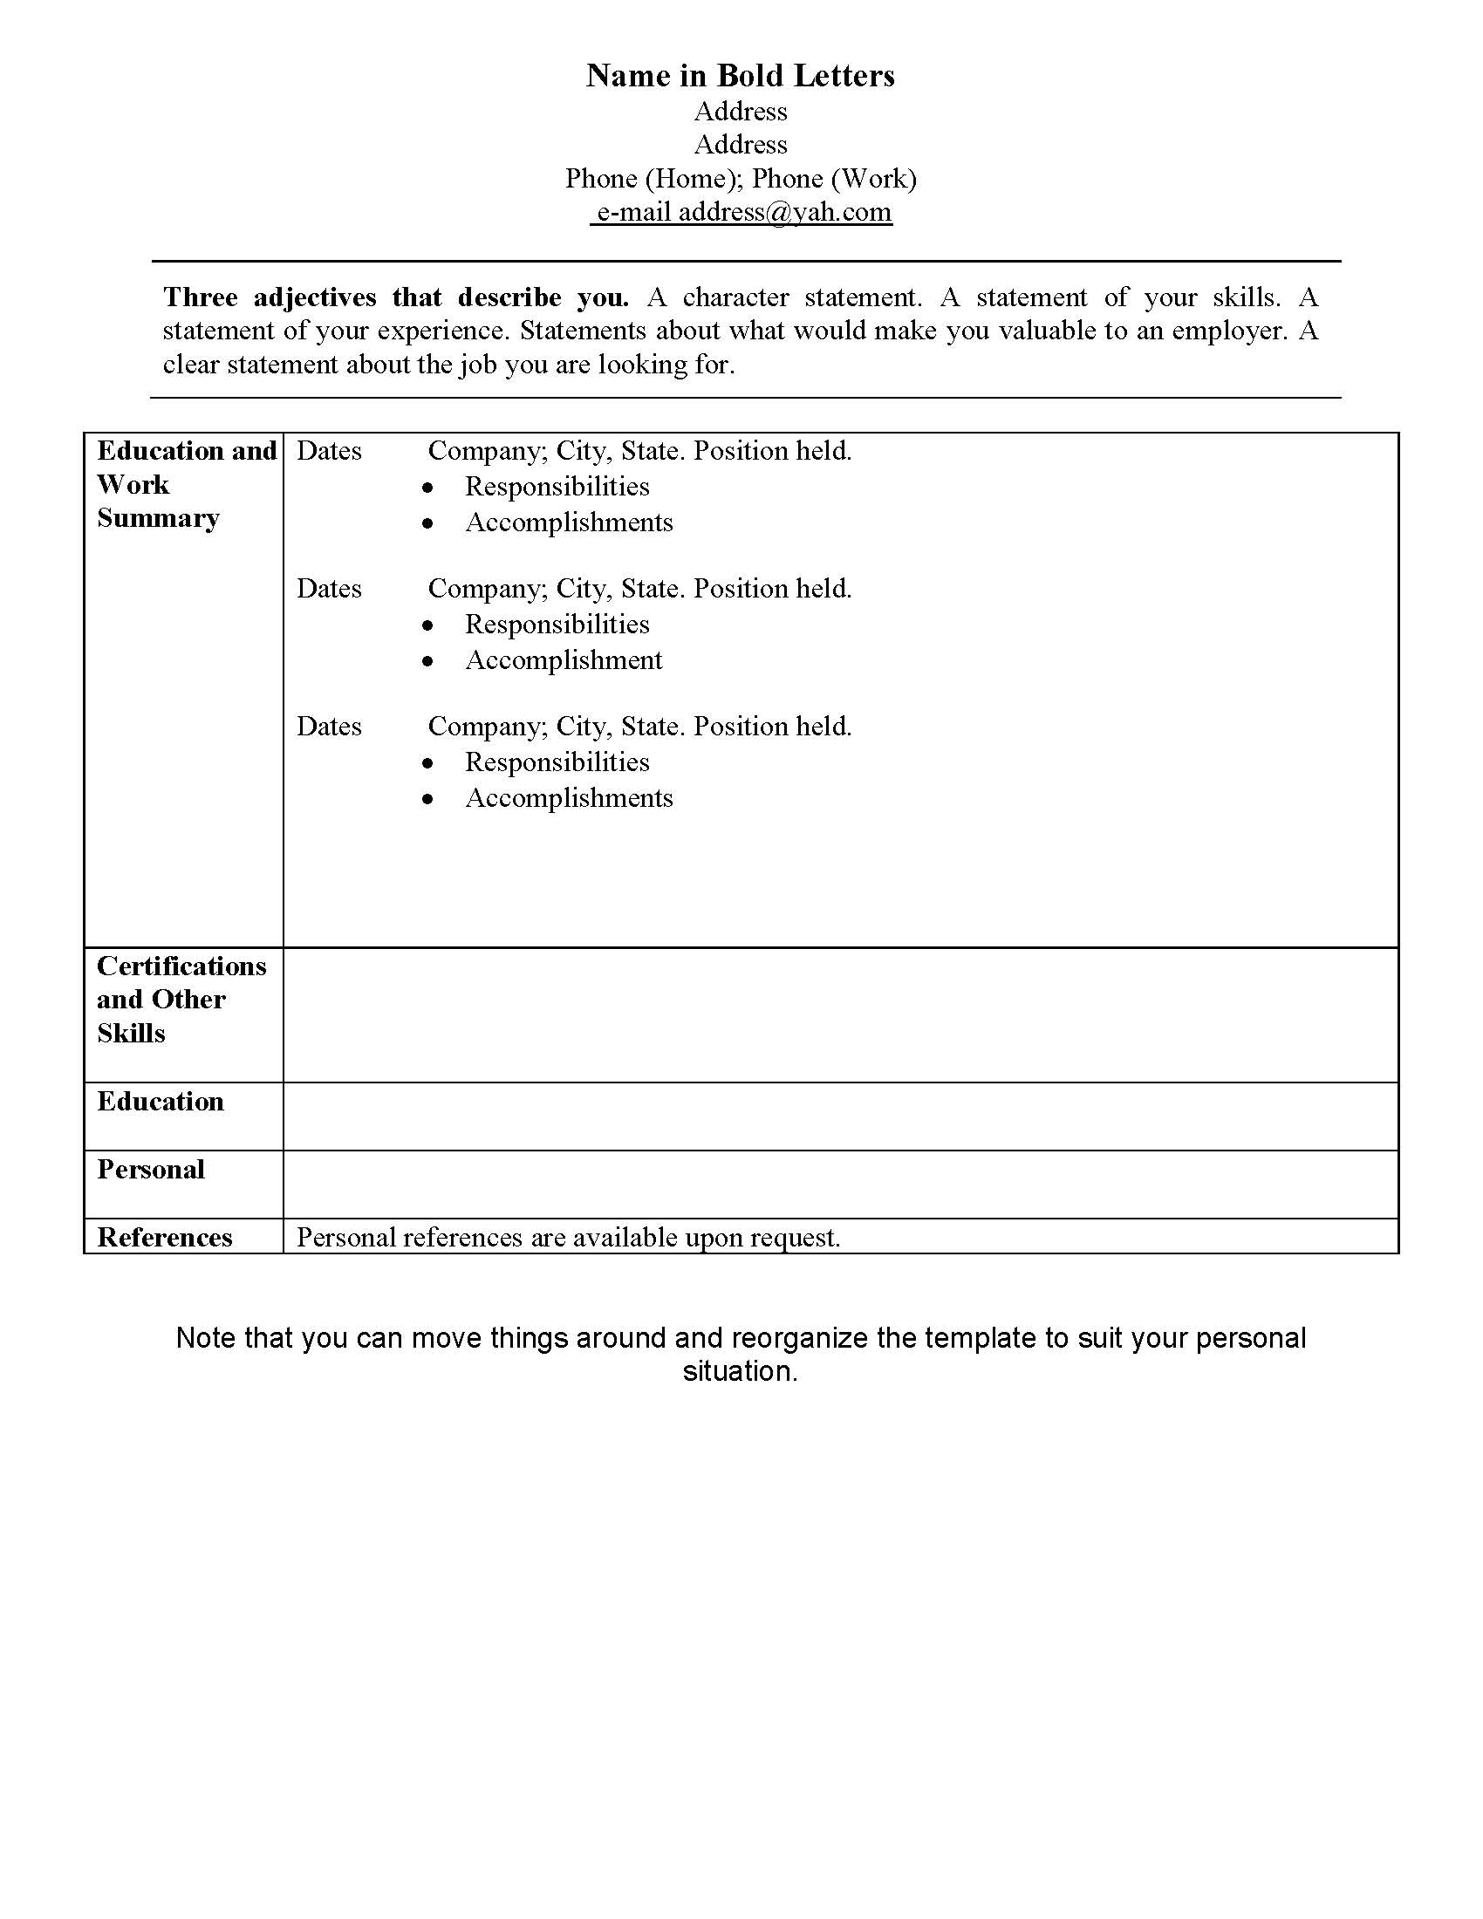
Putting it all together
Pull from answers to develop header of new resume and text for cover letters.
Your documents must have your words and your thoughts, not anyone else’s, for them to rightly represent you.
Build a template using tables
(Use WORD then delete the lines…)
Be consistent with punctuation
Metanoia Prison Ministries
29

Slide 30
Putting it all together
Contact block
Three adjectives
Working with people
Experience
Character statements
Work desired
Focus on skills
Previous employers
Education and training
Personal situation
References
Metanoia Prison Ministries
30

Slide 31
Putting it all together
Adapted to fit situation
Stresses character
Focus on employers
Professional Certs
Personal highlights
Metanoia Prison Ministries
31

Slide 32
Putting it all together
Expands on key point
Tells a specific story
Says what he wants
Fills in responsibilities
Metanoia Prison Ministries
32

Slide 33
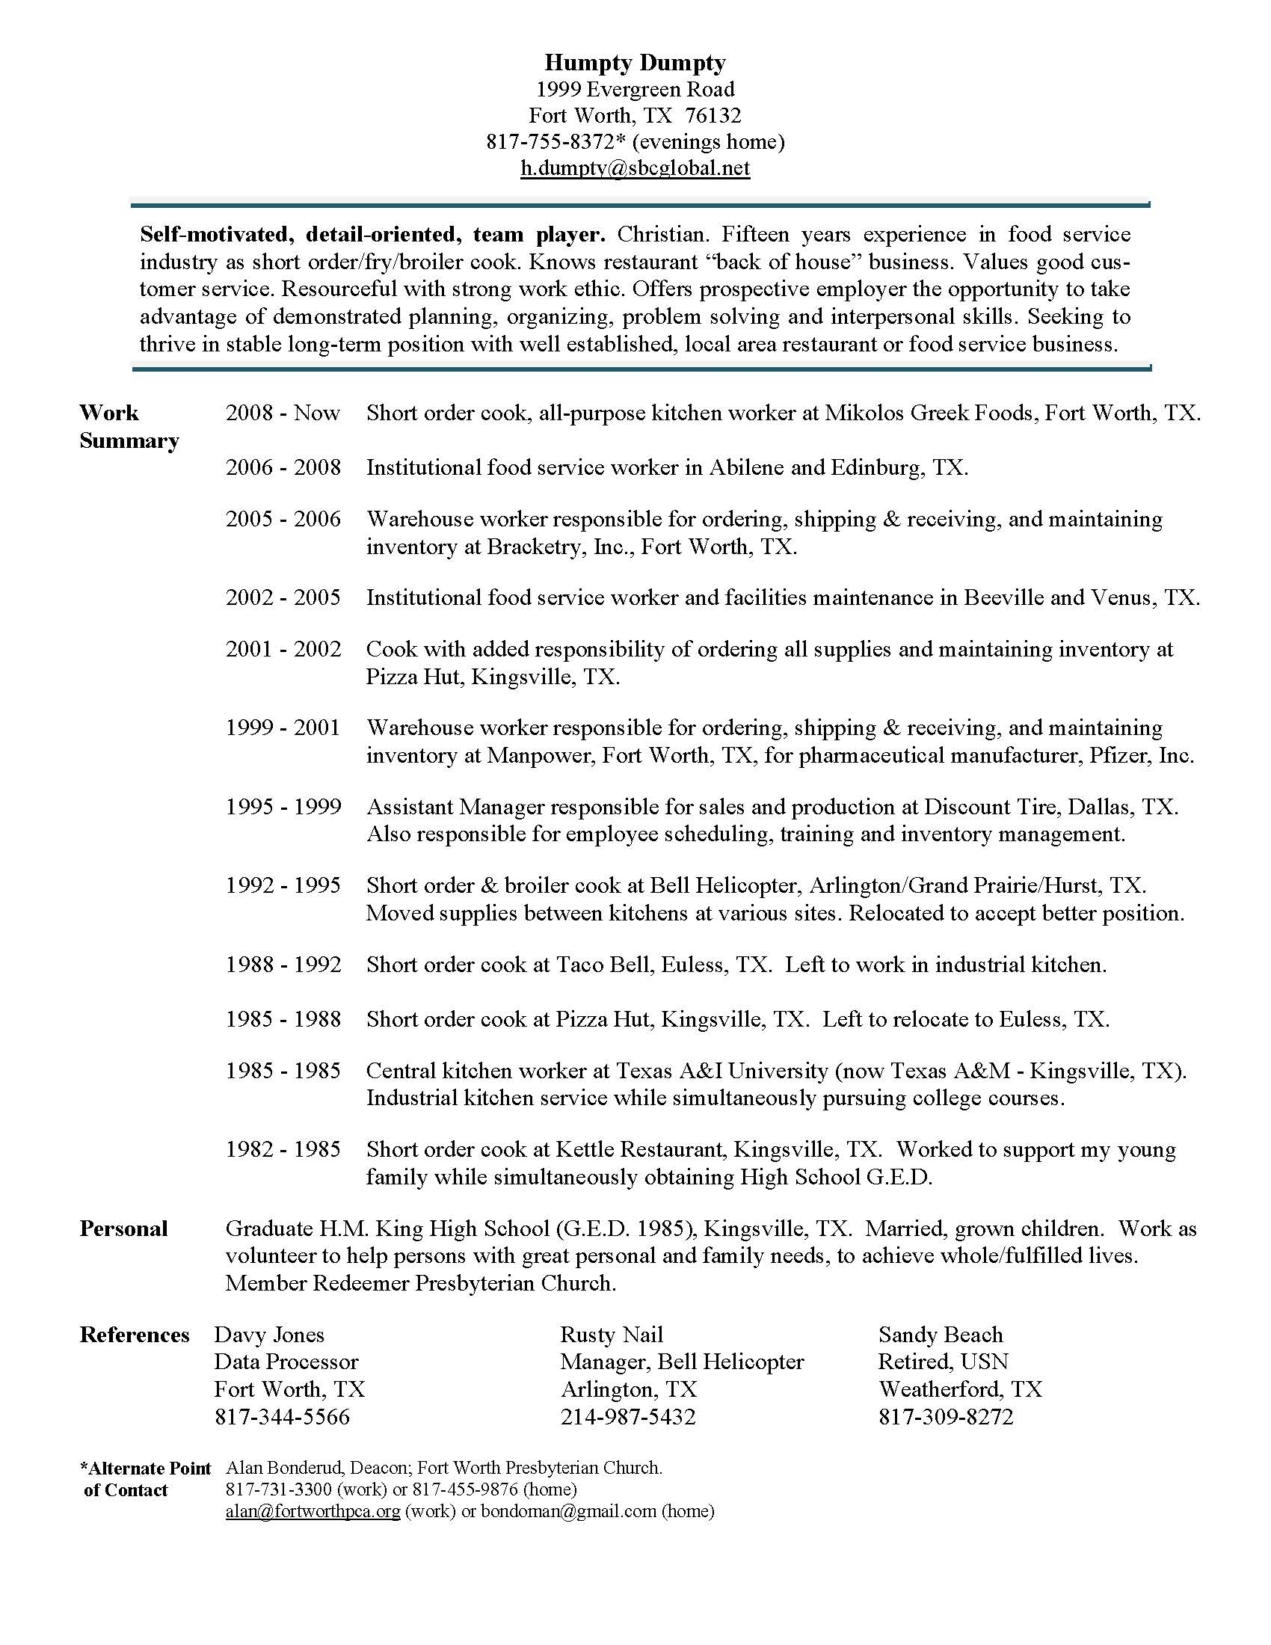
Putting it all together
You can make it work…
No daytime phone
Various periods of incarceration!!
List of good references
Show that your experience qualifies you for the job you seek
Metanoia Prison Ministries
33

Slide 34
Where Should I Begin Looking for a Job?
Start with your loves!
What would you do if you did not have to work?
What is your hobby?
What magazines do you read?
Where is your passion?
What do you love to do?
Work is hard - your passions can pull you through
You already are, or can become, an ‘expert’
You will interview well and will be valuable employee
Imagine getting paid for being around peopled, places and things you love
Metanoia Prison Ministries
34

Slide 35
Where should I begin looking for a job?
Examples:
Things I love… | Where I would begin looking for a job…
Airplanes | Airports City and county aviation departments Airlines Airplane parts companies Airplane manufacturers
Animals | Zoo Humane Society Racetrack Veterinary hospital
Food | Restaurants Hotels Cooking schools
Working with my hands | Company maintenance departments Construction companies
Don’t you think that a loving God wants you to have the desires of your heart?
Think creatively about this. Make it the place to start your job search
Do not give up on your dreams
Consider entry level position to get in your desired industry
Consider volunteering to get your foot in door
Metanoia Prison Ministries
35

Slide 36
Where do I find places to ask for a job?
Ask friends at home and at church
Membership directory from city Chamber of Commerce (on-line)
Reference USA Database off almost any Public Library System
Community Christian Chamber of Commerce
“Hard-2-Hire” website
Temporary agencies
Professional organizations
State, County and City websites
Craig’s List in the community you want (posting yourself and answering ads for work)
Volunteer and work your way into a job
At training school or where you are earning education
Pray for wisdom, then pray again...
Computer is necessary so a mentor or family can help here
Don’t simply apply to jobs already posted on-line; thousands of people do this, too…
Create your opportunity
Use filters to find just the right company in the area you want
Send two letters per company
Remember to follow-up
Metanoia Prison Ministries
36

Slide 37
Persistence will pay off
Your Next Steps...
Fill out workbook pages
Keep for future reference -or-
Review with your mentor, family member, pastor, etc. asking, “Does this look like me?”
Load template on local computer
Create initial drafts for two or three specific areas you will explore
Return to your mentor or counselor with thoughts, questions , etc.
Thank you for your persistence
in this work!
This is not a prosperity gospel presentation
We will seek first the Kingdom of God and His righteousness
You are uniquely equipped to serve
Mine for opportunities
This will be hard, but it is not impossible; do not be discouraged or dissuaded
Our God is all in for your good
Metanoia Prison Ministries
37

Slide 38
Loving and Trusting God in the Job Search
Pre-Release Workbook and Planning Guide
for Returning Citizens
Courtesy of the Metanoia Prison Ministries
For additional information contact:
Mark Casson
Director of Prison Ministry, Presbyterian Church in America
Executive Director, Metanoia Prison Ministries
www.metanoiaprisonministries.org
© 2014 Metanoia Prison Ministries
Permissions: You are permitted to reproduce and distribute this material provided that you do not alter the wording in any way and do not charge a fee beyond the cost of reproduction. Any exceptions to the above must be approved by Metanoia Prison Ministries.
Metanoia Prison Ministries
38

