Slide 1
Community Mentoring Ministry at
Walker State Faith and Character Prison
Introduction to Mentor Ministry at
Walker State Faith & Character Based Prison
and
State of Georgia
Formal Application Process
February - March 2020
REVISED 2/24/2020

Slide 2
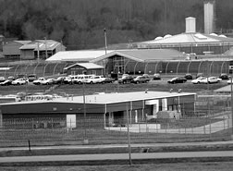
Community Mentoring Ministry at
Walker State Faith and Character Prison
Open Invitation to Men in
Chattanooga - Dalton - NW GA
Introduction and Steps to Take
“Remember the Prisoner…”
JOIN US !!
Mentor Men at Walker State Faith and Character Prison

Slide 3
To: Christian Men, Pastors, Elders, Deacons, Outreach Ministries From: Metanoia Community Mentoring Ministry
Community Mentoring Ministry at
Walker State Faith and Character Prison
Open Invitation to Christian Men in Chattanooga - Dalton - NW Georgia
Walker State Prison in nearby Rock Spring, GA, is one of a few faith and character prisons in the U.S. Local churches were asked to form a mentor ministry as a key component of this work. Bathed in prayer, results exceeded expectations. Join us in this powerful ministry!
More than 230 men from 75+ churches of all denominations have been trained to mentor one-on-one, every two weeks, in 1¾-hour evening sessions, deep inside the prison;
Prisoners voluntarily request Christian mentors to disciple and help transform their lives;
The rate at which our mentees return to prison <2% versus a national average of ~60%;
There are >100 prisoners on a waiting list requesting Christian mentors;
This as an interdenominational work of Metanoia, the national prison ministry of the Presby-terian Church in America, with resources to engage, educate, and equip Christians to serve.
Most of our churches don’t, have prison ministry, but they do have men from their congre-gations, led by the Spirit of God, who can spend themselves in merciful service. These men and the people in the churches who pray for and support them will not stand ashamed when before Christ in judgment He says, “I was in prison…” (Matt 25:36)
Ministry to prisoners is the work of the Church. Please read through this little presentation. Then consider how you would like to participate in this vital ministry.
Thank You Very Much!

Slide 4
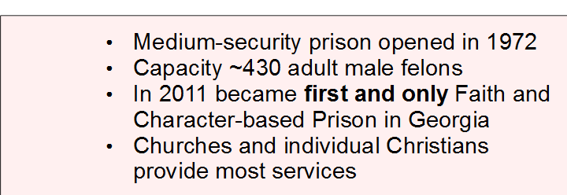
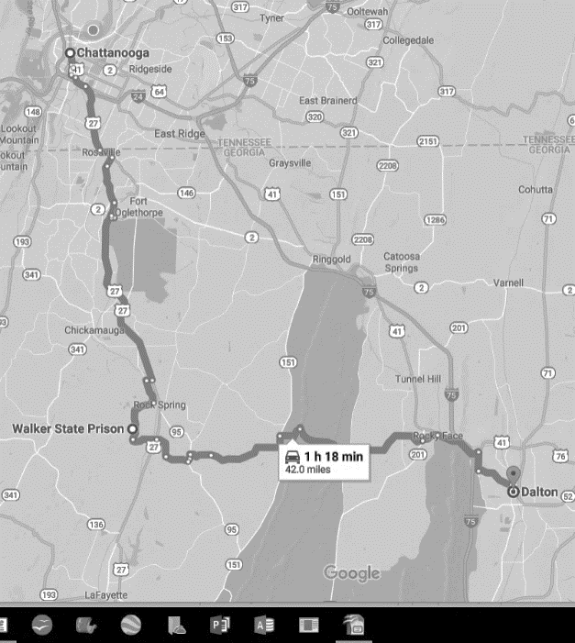
What and Where is
Walker State Faith and Character Prison?
Community Mentoring Ministry at
Walker State Faith and Character Prison
Chattanooga
Walker State Prison
Dalton

Slide 5
Mentors Meet Prisoners One-on-One to Disciple, Build Bridges, and Prepare for Release
Community Mentoring Ministry at
Walker State Faith and Character Prison
Disciple | Reveal Christ Be a friend Overcome deep hurting Prevent life from spiraling into “institutional nothingness” Restore God-centered self esteem; key to good choices Teach, rebuke, correct and train in right righteousness... empower new lifestyle through teaching of the Word Prepare men to lead families & make disciples upon release
Encourage Rebuilding Bridges with Family | Model godly and manly man-to-man relationships Help overcome deep shame felt by inmate and family Help deal with life changes that go on in the family in inmate's absence including births, deaths, weddings, graduations, etc.
Prepare for Release | Help establish goals, acquire hope, and gain a vision so there really can be seen a light at the end of the tunnel; equip to be productive godly citizen Provide structure to build confidence prior to release or transition back into the general prison population in Georgia

Slide 6
Practical Details
Community Mentoring Ministry at
Walker State Faith and Character Prison
Personal Requirements
Be member in good standing of a Christian church
Able to meet your mentee twice per month from 7:00 p.m. - 8:45 p.m.
You pick which group to join for meetings held on the 1st and 3rd or 2nd and 4th Monday, Tuesday, or Thursday nights of the month
Prospective mentors…
Must complete an application form and agree to allow the State of GA to conduct a simple background check
Receive mandatory training by both Metanoia Ministries (2-1/2 hrs.) and State prison officials (4 hrs.)
Training covers Biblical Basis of Ministry, Intro to Inmates and Prison Culture, State and Federal Regulations, The Do’s and Don’ts in a Prison
Complete paperwork for matching
Have photo taken for official GA Certified Volunteer badge
Match up with a prisoner and receive details about first meeting
See https://wspmentoringministryevents.shutterfly.com
for many more details

Slide 7
Still Interested?
What Should You Do Now?
Community Mentoring Ministry at
Walker State Faith and Character Prison
First steps to take
Pray
Follow the steps shown in this packet of information to apply
If you still have not made up your mind
Call us for more information (see last page for contact points)
Accept offer to visit one time during mentor evening to observe
Help us open doors to present this work to more men
Tell us with whom we can have a personal call or visit at church
Arrange small group meeting with interested individuals
Set meeting with church leadership, outreach, mercy ministry teams
Invite us to meet with your men’s ministry
Make time for us to talk at Sunday School or pulpit during worship

Slide 8
Steps to Take (1 of 6)
Community Mentoring Ministry at
Walker State Faith and Character Prison
Men wanting to apply to become mentors follow this process.
Training and orientation will be held on two different days, with mentor training at a local church and the formal State certification training accomplished at the prison.
The registration process is done online and is managed by the State of Georgia. YOU MAY GO ONLINE TO DO THIS NOW OR BRING THIS WITH YOU TO THE NEXT MENTOR TRAINING CLASS WHERE WE WILL WALK YOU THROUGH THE PROCESS.
Step 1
Applicant sends notification email:
To… Chaplain Aaron Reaves
Walker State Faith and Character Based Prison, Rock Spring, GA
aaron.reaves@gdc.ga.gov
Applicant advises interest in serving as mentor with Metanoia / Community Mentor Ministry
Cc… Barry Smith, Regional Director - Northwest Georgia & Tennessee
Metanoia Ministries
bsmith@pcanet.org
Cell (786) 518-6736
Steven Howell, Mentor Ministry Facilitator
Metanoia Ministries
metanoiamentoring@pcanet.org
Cell (314) 800-4191

Slide 9
Steps to Take (2 of 6)
Community Mentoring Ministry at
Walker State Faith and Character Prison
Step 2 Applicant doesn’t wait for response but with instructions provided here, goes to http://www.gdc.ga.gov/content/Volunteer_Services
Step 3 Applicant clicks on “Click Here to Begin Application Process” just below the photo of Steve Turner, the Director of Chaplaincy Services. Prospective mentors in the following instructions are referred to as Applicants.
Step 4 Be sure to at every step you are looking at the full screen. Be sure nothing is hiding in the edges. You could miss click-boxes and get INVALID REQUEST warnings. These must be clicked to prove you are NOT a ROBOT! Men have failed because they missed this. Also be sure you do not miss little cues, arrows, and notes directing you to complete things you may have missed. Sometimes these come up in the margins. Just a word to be mindful of everything on the screen.
Step 5 Applicant watches orientation video from Dr. Steve Turner. Listen particularly for questions concerning the following points. a) New volunteers’ greatest concern (SAFETY), b) What your training will cover (DO’s & DON’Ts), c) The individual you contact regarding your interest (CHAPLAIN), d) How long it will take to process your application (3-4 WEEKs)
Step 6 Applicant will take a brief quiz which covers information from Dr. Turner’s video
Step 7 Once quiz is completed, the applicant will watch an informational video

Slide 10
Steps to Take (3 of 6)
Community Mentoring Ministry at
Walker State Faith and Character Prison
Step 8 After the video, the applicant will complete and submit the online application following all the instructions found in this document
Step 9 The application is automatically sent to Chaplaincy Services for processing which normally will take approximately four weeks
Step 10 The applicant (you) then should advise Chaplain Reaves, Alan Bonderud, and Steven Howell that you have completed the online process
Step 11 If the volunteer application is approved, the State will notify applicant of upcoming training to take place at Walker State F&CB Prison
Step 12 The applicant (you) then advises Chaplain Reaves, Alan Bonderud, and Steven Howell of his intent to attend training on the selected date
Step 13 We will send applicant several forms to complete and return to us. Alternatively, these may be completed at the mentor training occurring at a local church.
1) Request for roster information,
2) Mentor matching questionnaire, and
3) Limitation of liability waiver
Step 14 We will send applicant driving directions and additional relevant information

Slide 11
Steps to Take (4 of 6)
Community Mentoring Ministry at
Walker State Faith and Character Prison
Step 15 Applicant will attend 2-1/2-hour morning mentor ministry training at local church given by Metanoia / Community Mentor Ministry.
On another day, applicant will attend 4-hour afternoon training at Walker State F&CB Prison given by Walker staff.
Step 16 When the applicant has completed trainings and been issued a badge, the mentor ministry will match the new mentor with a prisoner, send the new mentor information about the prisoner, the mentor’s assigned Group, Group Leader, starting night, etc.
Questions? If the applicant has any questions or concerns about the State’s web-based, volunteer application process, he should email aaron.reaves@gdc.ga.gov
For all other questions about the mentor ministry, the applicant should contact Barry Smith or Steve Howell. See last page for contact points.

Slide 12
Steps to Take (5 of 6) - Online Application Instructions
…Have the Following Information on Hand !!
Personal emergency contact name/relationship/phone number; use no hyphens in phone #s
Name of the Group/Organization you are volunteering with: Community Mentoring Ministry
Your group facilitator name: Steven Howell
Your group facilitator email address: metanoiamentoring@pcanet.org
Your group facilitator phone number: 3148004191 (use no hyphens)
Your group emergency contact name: Barry Smith
Your group emergency contact number: 7865186736 (use no hyphens)
The username of your Facebook, Twitter, Instagram, or other social media account you use.
Address/duration (mo/yr) of all places where you have lived in the previous five years
Your activities over past 5 yrs, including military, work, and volunteer organizations including the street address, and telephone number. You can list your church and you as MEMBER.
Under “Areas of Interest” We instruct prospective mentors to check MENTORING
On Page 4 - PERSONAL INFORMATION a date is asked for at the top of the page. You can put the date you are filling out the form.
On Page 4 - OCCUPATION. If retired, it kicks you out unless you fill in OCCUPATION, BUSINESS NAME AND BUSINESS ADDRESS (two lines). Enter the word RETIRED on all four lines. It will ask you for your BUSINESS PHONE even if you are retired. Just enter your home phone.

Slide 13
Steps to Take (6 of 6) - Online Application Instructions
…Have the Following Information on Hand
14. There is a place where it askes for your DRIVER’S LICENSE NUMBER
In another place when you give home address, it asks also for COUNTY. Unfortunately, it only gives a list of counties in Georgia. If you live in another state, just enter WALKER.
Be sure to specify you are interested in WALKER STATE PRISON.
If it asks you where did you learn about serving as a volunteer with the Georgia Department of Corrections, you may try to leave that blank.
When the process is coming to a conclusion, you may see orange bubbles with warnings that errors were made. Please return to the necessary spots and repair.
Then, upon conclusion of the process, you will be sent an email to confirm that you are the real applicant. Click on the appropriate place. You are finished!
If you see anything in these instructions that needs changing or updating, please feel free to contact us and we will make the necessary adjustments. It is too important not to…

Slide 14
We Will Pray as We Stand-by for
You to Take Steps to Inquire or Join
Community Mentoring Ministry at
Walker State Faith and Character Prison
Remember. There are more than 100 men in State custody with their Warden’s permission to be on a waiting list for Christian men who will minister life-on-life, discipling them so they might live well by faith in Christ. The Church cannot neglect this call.
Barry Smith
(786) 518-6736
bsmith@pcanet.org
Steven Howell
(314) 800-4191
metanoiamentoring@pcanet.org

